Slide 1

Impact Project Presentation
Sai Vikram

Slide 2
What is Data Mining?
Data mining in simple words can be told as , extracting patters from data available so that the organizations gain some knowledge out of the patterns.
What to do next
Forecasting
More Profit
Avoid Dead Stock
Understand Customers
etc
Data Source
DataCollection,Cleaning,Making it ready
Mining interesting Patters as required
Patterns
Data Source

Slide 3
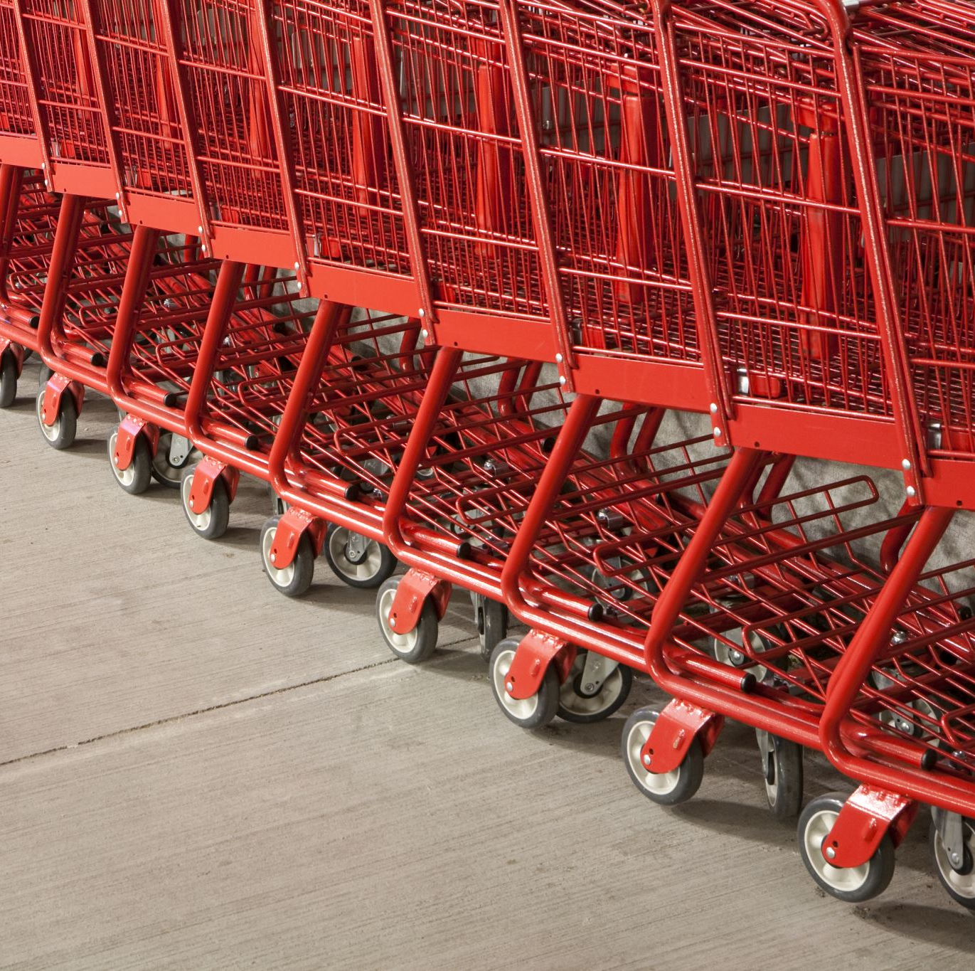
Walmart
Walmart in simple words is a retail store, which has many branches or outlets in many places
In 2015 Walmart is the largest retail chain in the world in terms of retail revenue.
Walmart platform is based on extensive big data ecosystem for online marketing with more than 200 Hadoop nodes and a powerful analysis engine.

Slide 4

Why does Walmart need Data Mining
Walmart transactional data bases are estimated to contain more than 2.5 penta bytes of data about their products ,customers etc.
What does Walmart do with this data?

Slide 5
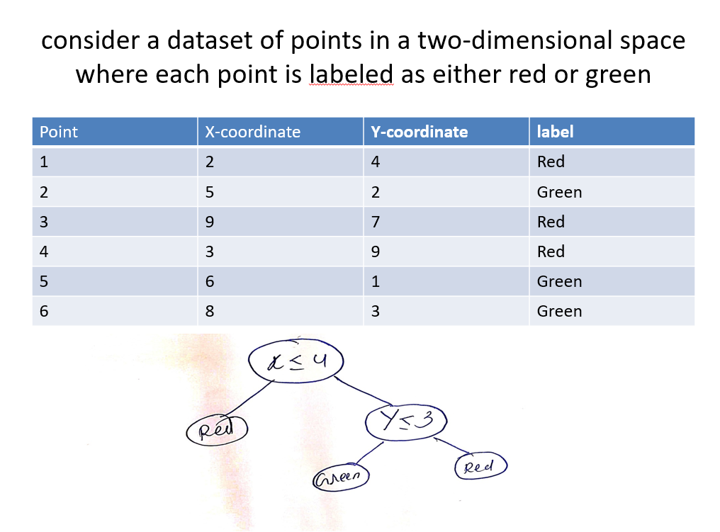
Data Mining Methods Used by Walmart
DECISION TREES:A decision tree is a supervised machine learning algorithm . It typically has two nodes I)decision node II)leaf.The goal is to maximize the information gain at each split. Entropy is the measure of information contained in a state.Entropy=sigma -pi log(pi).

Slide 6
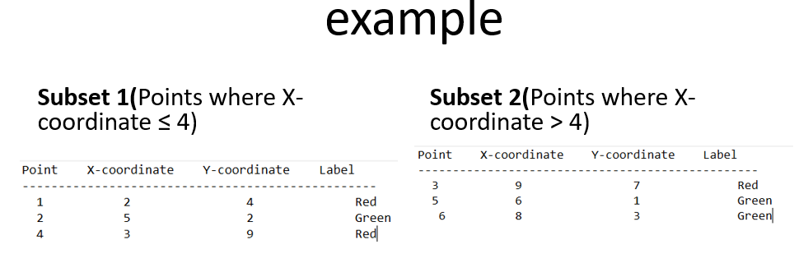
Data Mining Methods Used by Walmart
RANDOM FOREST:Random Forest is an ensemble learning method. it mixes numerous decision trees to produce predictions that are more accurate. To construct a fresh training set, it first randomly selects a portion of the training data using bootstrap sampling. Random Forest is parallelizable

Slide 7
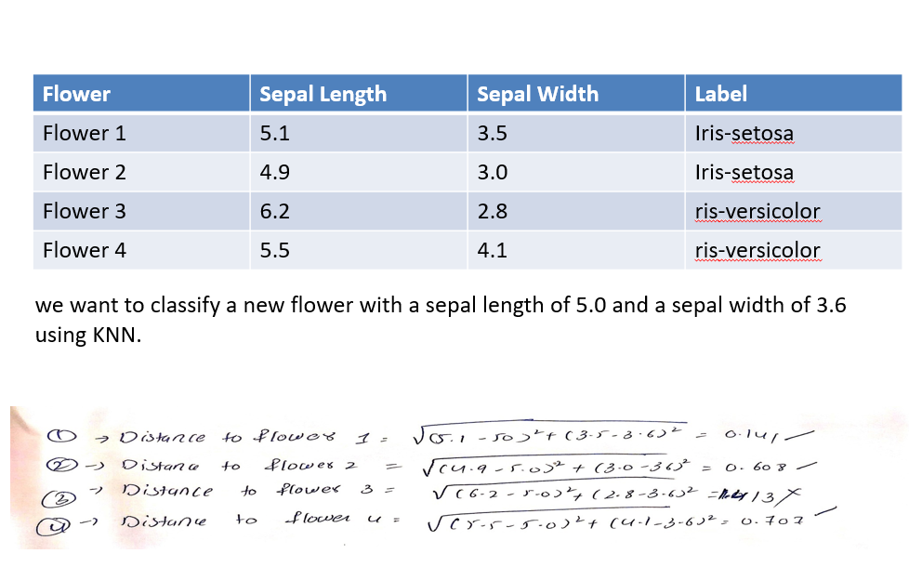
Data Mining Methods Used by Walmart
K-NEAREST NEIGHBORS:supervised machine learning algorithm. It is a sort of instance-based learning that is non-parametric and makes predictions based on the similarities between fresh data points and the training data.It has majorly two phases Training phase,Forecasting phase.

Slide 8

Data Mining Methods Used by Walmart
XGBoost Regressor
Walmart uses XGBoost, a powerful algorithm that combines decision trees, to train a model. The model learns from historical data to make predictions. It goes through many rounds of training, where it repeatedly corrects its mistakes and improves its accuracy.
The optimal values for xgboost algorithm are selected using hyperparamter values.

Slide 9
Data Mining Methods Used by Walmart
Sentimental Retrieval:
What is sentimental Retrieval?
Semantic retrieval at Walmart means searching for products based on their meaning or context, rather than just looking for exact matches to keywords. It's about understanding what users want and finding products that match their intent
Why do we need sentimental Retrieval?
Especially helpful for specific and uncommon search terms. Instead of only focusing on the words themselves, semantic retrieval considers the overall meaning behind the words to provide better search results.

Slide 10
Data Mining Methods Used by Walmart
The idea of sentiment analysis was not only limited to product search but , it was also used to analyse the comments of social media.
Real Time Example:
Sentimental Analysis on Twitter Comments
People tend to talk more about Costco’s muffin and cookie more than Walmart’s Muffin and cookie .

Slide 11
Real Time Example where forecasting was useful for Walmart
When USA was affected by Hurricane Ivan ,Towards florida Coast,Walmart decided to mine sales before Hurrican Charlie stuck on the before weeks.
And the experts after mining found out that strawberry Pop-Tarts increase in sales, like seven times their normal sales rate, ahead of a hurricane.
So the Walmart made sure that they had enough stock of strawberry pop – tarts in Walmart , so amazingly they ended up in good profits,

Slide 12
Privacy, Security Social ,Concerns Point Of View
Privacy: These data mining techniques involve large amounts of data, which may include personal information. If not handled carefully, there is a risk of privacy breaches, where sensitive data is exposed or used without consent.
Walmart must take measures to protect customer information and ensure compliance with privacy regulations to maintain consumer trust.
Security: Data mining techniques require storing and processing significant amounts of data. It's crucial for Walmart to implement robust security measures to prevent unauthorized access, data breaches, or hacking attempts.
Protecting customer data from cyber threats is vital to maintain the integrity and confidentiality of personal information
Social Concerns:The social concerns of data mining techniques in Walmart can be seen from 2 sides, while the first side is positive , it is helping to understand people so as to provide them what they want, while the negative can be there is a chance that Walmart may do personalized targeting which may affect privacy and may lead to discrimination, and customer manipulation.

Slide 13
Walmart says that the data it collects is safe and do sell or rent the information .
Walmart also says that they use SSL(Secure Socket Layers) Encryption, this is basically a protocol that ensures that the data sent between a user's web browser and a website's server remains private and cannot be intercepted or tampered with by unauthorized individuals

Slide 14
An article in “Firewall Times” [April,2023]
A lawsuit has been filed against Walmart, claiming that hackers breached the company's official website and stole customer data, including personal information and financial details.
The lawsuit alleges that the stolen data was sold on the dark web. The exact number of affected customers is unspecified but believed to be in the thousands.
Under the California Consumer Privacy Act, Walmart could be liable to pay $750 to each affected customer.
Walmart denies the breach and plans to contest the allegations in court, stating that the failure of their systems did not contribute to the exposure of customer data.

Slide 15
Some More Real Time Scenarios
January 2021: A security flaw on Walmart Canada's website exposed customer data, including names, addresses, order details, and payment information.
March 2019: Employees of third-party vendor Compucom were investigated for unauthorized access to internal Walmart emails, potentially seeking a competitive advantage.
July 2015: Walmart Canada and CVS experienced a potential data breach involving a third-party vendor, PNI Digital Media, potentially impacting millions of customers' credit card information.

